Slide 1
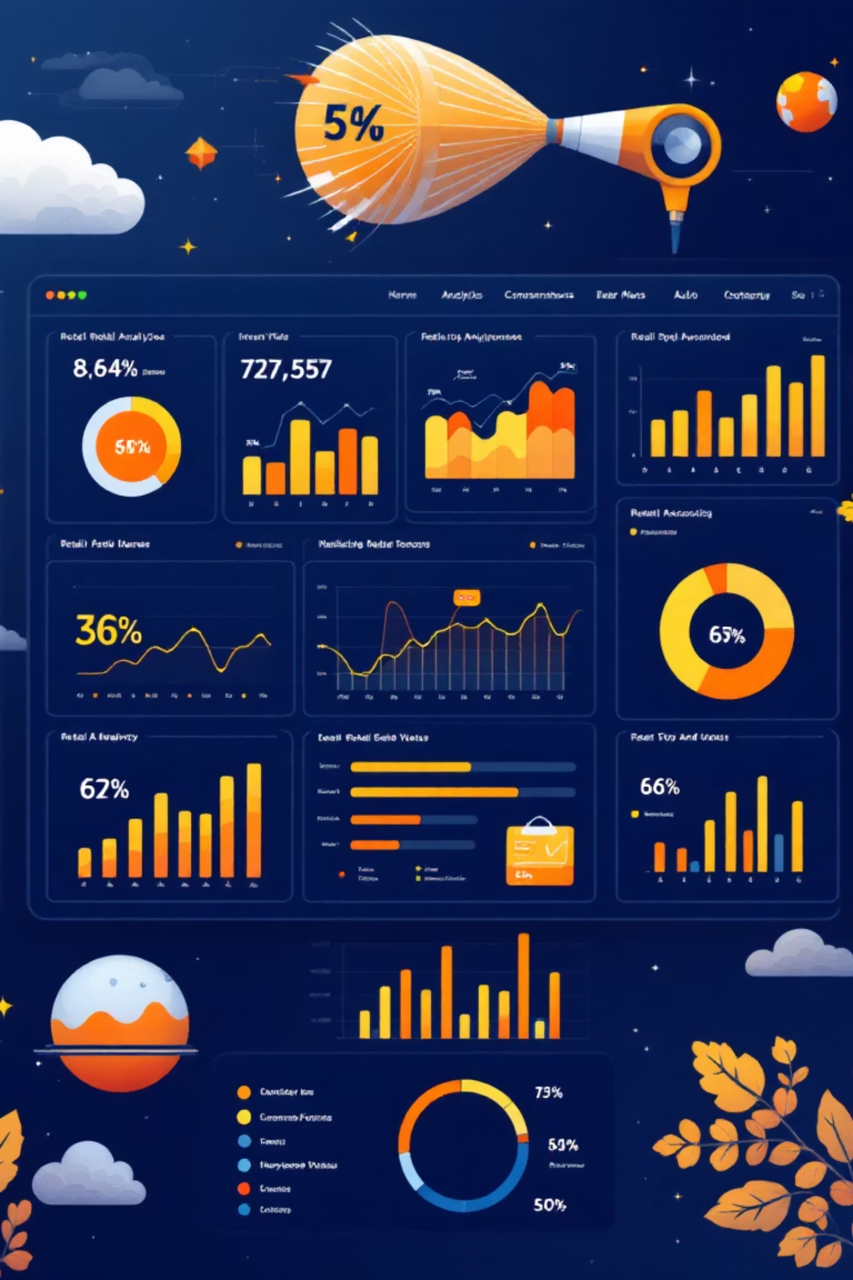
Customer Shopping Behavior Analysis
Analyzing 3,900 customer transactions to uncover spending patterns, preferences, and opportunities for strategic growth.

Slide 2

Project Overview
Goal
Data Source
Key Question
Uncover insights into spending patterns, customer segmentation, product preferences, and subscription behaviors to support data-driven decisions.
POS System tracking 3,900 purchases across various product categories with 18 key features.
How can we leverage shopping data to identify trends, improve engagement, and optimize strategies?

Slide 3

Dataset Structure
Customer Demographics
Shopping Behavior
Age, gender, location
Frequency of purchases
Subscription status
Review ratings
Previous purchase history
Shipping type preferences
Purchase Details
Data Quality
Item, category, amount
Only 37 missing values in review ratings. Clean dataset with 4 integer, 1 float, and 13 object columns.
Season, size, color
Discount and promo usage

Slide 4
Data Preparation Process
01
02
03
Handle Missing Data
Consistency Checks
Standardize Columns
Imputed 37 missing review ratings using median rating per product category.
Removed redundant promo_code_used column after verifying it matched discount_applied.
Renamed all columns to snake_case for better readability and documentation.
04
05
Feature Engineering
Database Integration
Created age_group bins and purchase_frequency_days for deeper analysis.
Connected to SQLite for efficient SQL-based analysis and querying.

Slide 5

Revenue Insights
68%
839
Female Revenue Share
High-Value Discount Users
Female customers contribute nearly 68% of total revenue compared to male customers.
Customers who used discounts but still spent above average purchase amount.
Female customers drive the majority of revenue, while a significant segment of discount users maintain high spending levels.

Slide 6
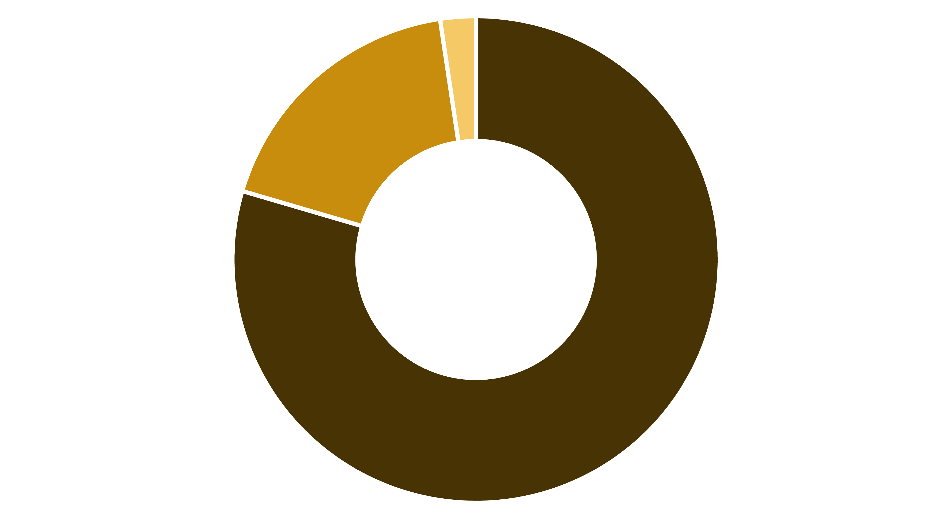
Customer Segmentation
Loyal
Returning
New
The customer base is dominated by loyal customers (80%), with returning customers making up 18% and new customers just 2%. This indicates strong retention but highlights opportunity for new customer acquisition.

Slide 7
Top-Rated Products
1
2
3
Gloves
Sandals
Boots
Average rating: 3.86
Average rating: 3.84
Average rating: 3.82
4
5
Hats
Skirts
Average rating: 3.80
Average rating: 3.78

Slide 8

Most Purchased by Category
Accessories
Footwear
Jewelry
Sandals
Sunglasses
Shoes
Belt
Sneakers
Clothing
Outerwear
Pants
Jacket
Blouse
Coat
Shirt
Discount Leaders: Hats, sneakers, coats, suits, and pants have the highest percentage of purchases with discounts applied.

Slide 9
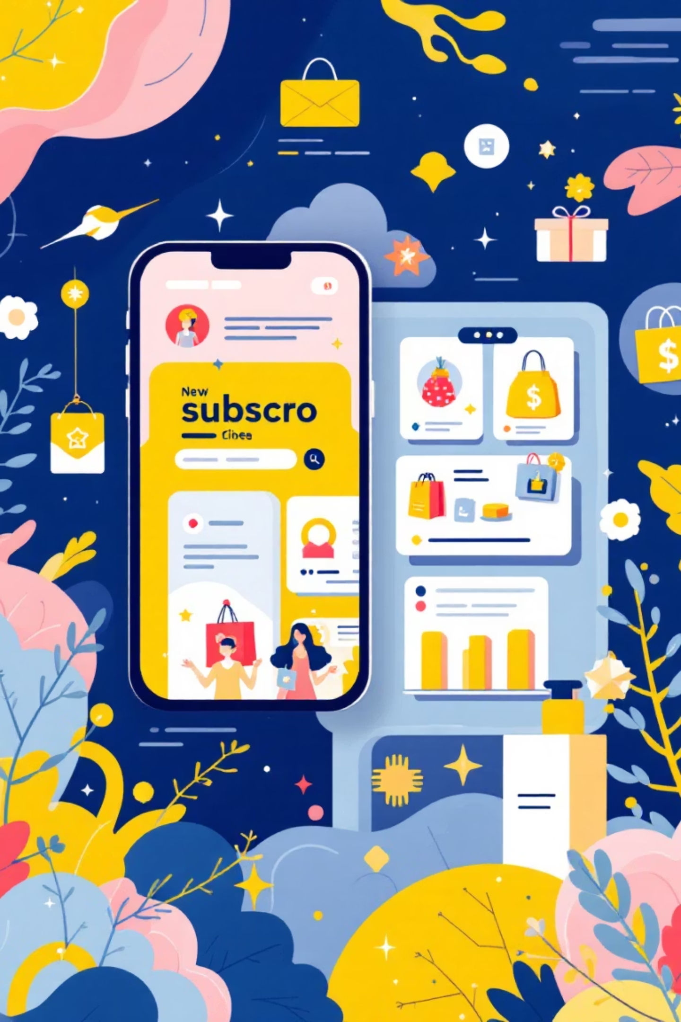
Subscription Analysis
Lower Subscriber Spending
Subscribers have slightly lower average spending and generate much less total revenue than non-subscribers.
Repeat Buyers Aren't Subscribing
Higher number of non-subscribers repeatedly purchase products. Repeat buyers with 5+ purchases are less likely to subscribe.
Current subscription model needs optimization to attract high-value repeat customers.

Slide 10
Strategic Recommendations
Boost Subscriptions
Loyalty Programs
Review Discount Policy
Promote exclusive benefits to convert high-value repeat buyers into subscribers.
Reward repeat buyers to move them from returning to loyal customer status.
Balance sales boosts with margin control for discount-dependent products.
Product Positioning
Targeted Marketing
Highlight top-rated and best-selling products in marketing campaigns.
Focus on high-revenue female customers and express-shipping users.

